Slide 1

CSE 473
Pattern Recognition

Slide 2
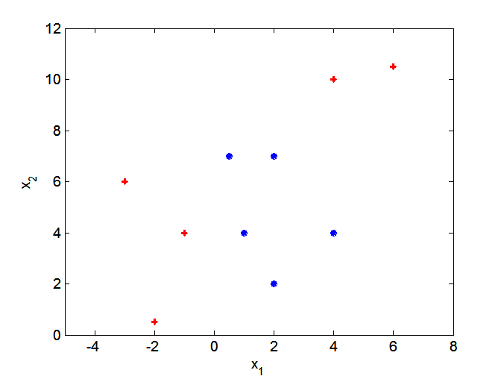
Non-linear Classifiers
Neural Network
Decision Tree
Non-linear SVM

Slide 3
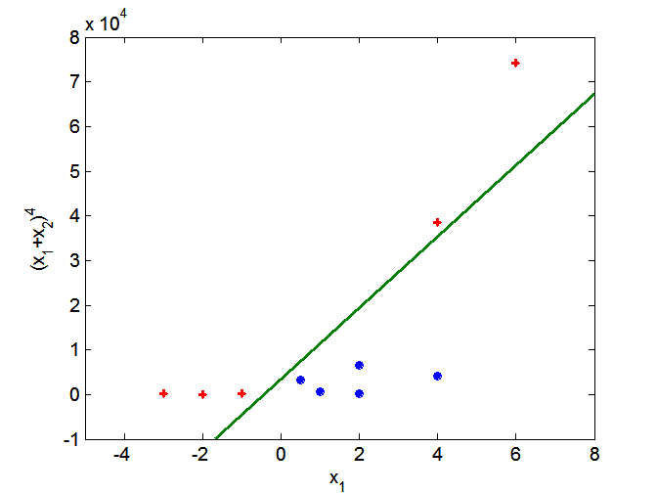

Non-linear SVM
Transform data into a different (possibly higher) dimensional space

Slide 4
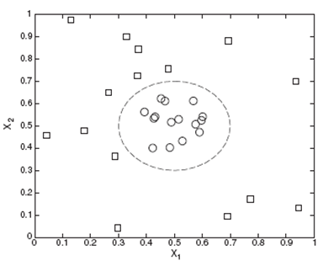
Non-linear SVM
Another Example

Slide 5
Non-linear SVM
Another Example

Slide 6
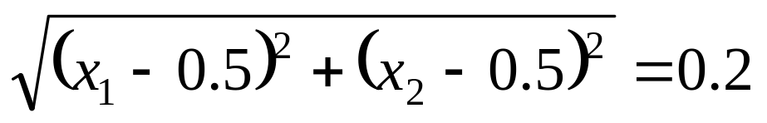
Non-linear SVM
Decision boundary:

Slide 7
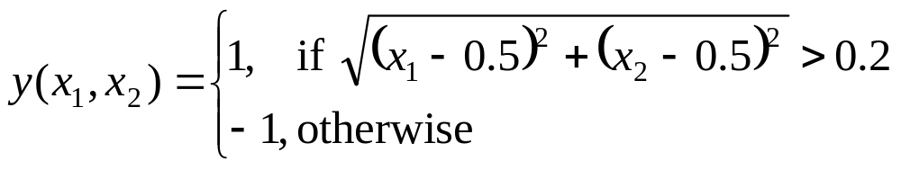
Non-linear SVM
Decision boundary:
2 classes are defined as

Slide 8
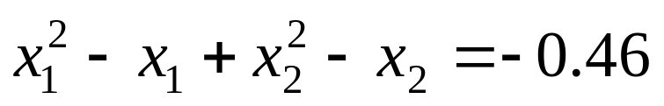
Non-linear SVM
Decision boundary:
can be written as

Slide 9
Non-linear SVM
Decision boundary:
can be written as
y₁
y₂

Slide 10
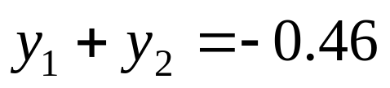
Non-linear SVM
Decision boundary:
can be written as
y₁
y₂

Slide 11
Non-linear SVM

Slide 12
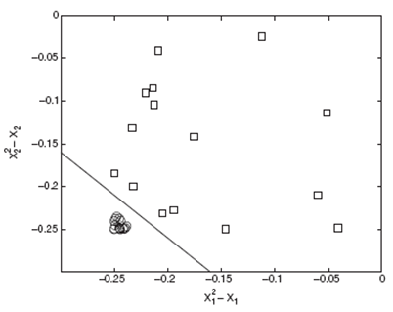
Non-linear SVM
x²₂ - x₂ = y₂
x²₁ – x₁= y₁
OR,

Slide 13
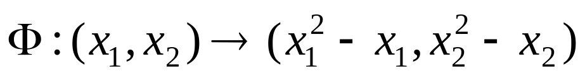
Non-linear SVM
We need a transformation like this

Slide 14
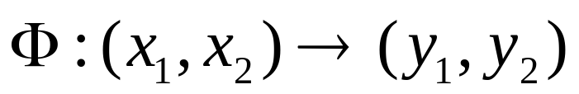
Non-linear SVM
We need a transformation like this
OR,

Slide 15
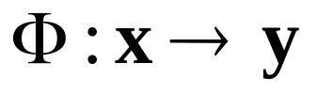
Non-linear SVM
We need a transformation like this
OR,
OR,

Slide 16
Non-linear SVM
We need a transformation like this
OR, more generally:

Slide 17
Non-linear SVM
With the transform
The equation of the classifier will be of the form:

Slide 18
Non-linear SVM
With the transform
The equation of the classifier will be of the form:
OR

Slide 19
Non-linear SVM
Transformation:
Classifier:
OR
The main idea: linear-separability increases as the feature dimension increases

Slide 20
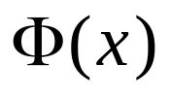
Formulation of a Non-linear SVM
With the new feature vectors , replace all x with in linear SVM

Slide 21
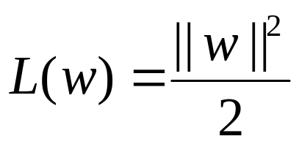
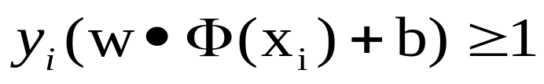
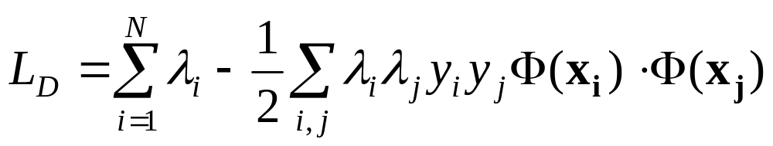
Formulation of a Non-linear SVM
With the new feature vectors , replace all x with in linear SVM
  Minimize
  Subject to
  The Dual function is:

Slide 22
Formulation of a Non-linear SVM
With the new feature vectors , replace all x with in linear SVM
  Minimize
  Subject to
  The Dual function is:
is called a kernel function

Slide 23
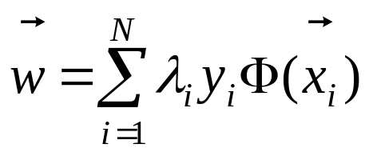
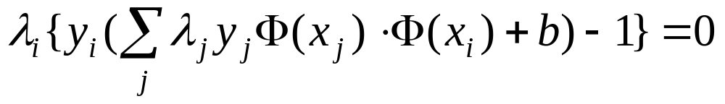
Non-linear SVM
Once we get the solution of λ’s, find w and b using following equations:

Slide 24
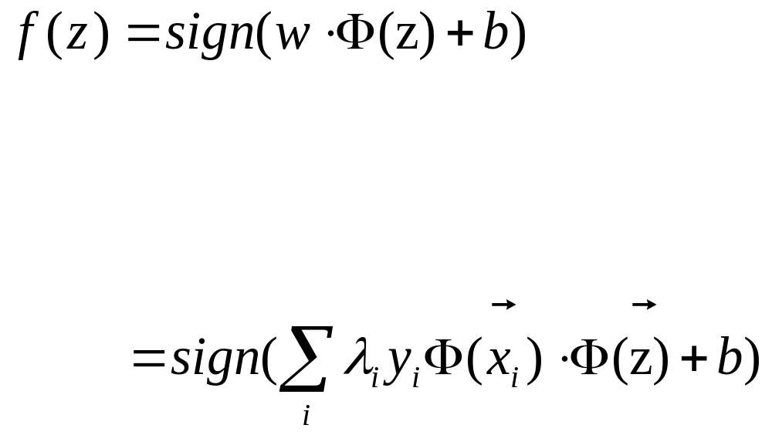
Non-linear SVM
The new object z is classified as:

Slide 25
Non-linear SVM
The new object z is classified as:
replacing

Slide 26
Non-linear SVM
The new object z is classified as:
replacing

Slide 27
Issues in Non-linear SVM
The mapping function is often unclear
Increase in dimensionality leads to high computation

Slide 28
Issues in Non-linear SVM
The mapping function is often unclear
Increase in dimensionality leads to high computation
Solution?

Slide 29
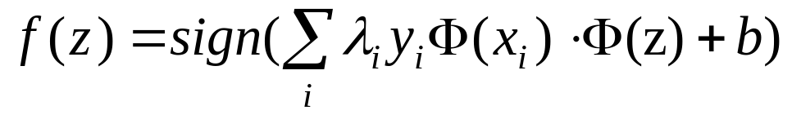
Issues in Non-linear SVM
Note the equations:

Slide 30
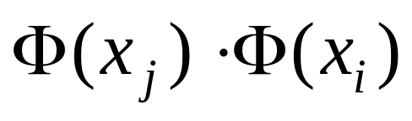
Issues in Non-linear SVM
Note the equations:
The dot product is a similarity measurement

Slide 31
Similarity/Distance Measurement
y
(4, 5)
(2, 3)
x

Slide 32
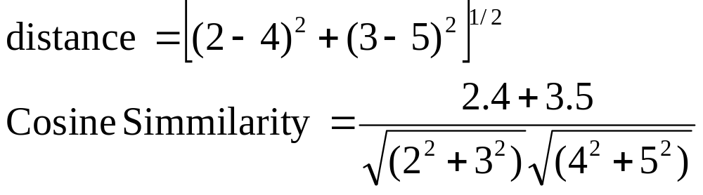
Similarity/Distance Measurement
y
(4, 5)
(2, 3)
x

Slide 33
Issues in Non-linear SVM
We can calculate the term in the original space using Kernel trick

Slide 34
Issues in Non-linear SVM
We can calculate the term in the original space using Kernel trick
Example:
Let

Slide 35
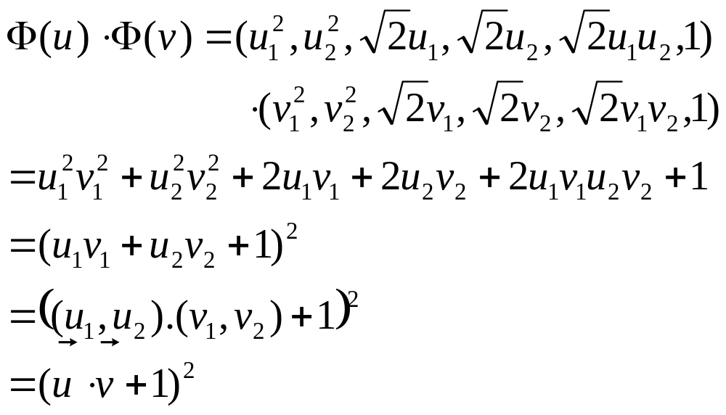
Issues in Non-linear SVM
We can calculate the term in the original space using Kernel trick
Example:

Slide 36
Issues in Non-linear SVM
We can calculate the term in the original space using Kernel trick
Example:

Slide 37
Issues in Non-linear SVM
We can calculate the term in the original space using Kernel trick
Example:

Slide 38
Issues in Non-linear SVM
We can calculate the term in the original space using Kernel trick
Example:

Slide 39
Issues in Non-linear SVM
We can calculate the term in the original space using Kernel trick
Example:

Slide 40
Issues in Non-linear SVM
We can calculate the term in the original space using Kernel trick
Example:

Slide 41
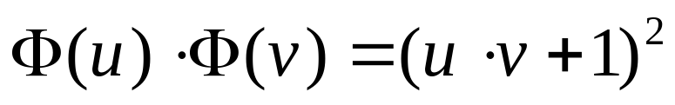
Issues in Non-linear SVM
Kernel trick

Slide 42
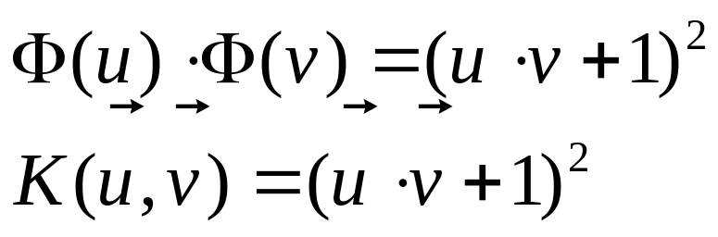
Issues in Non-linear SVM
Kernel trick

Slide 43
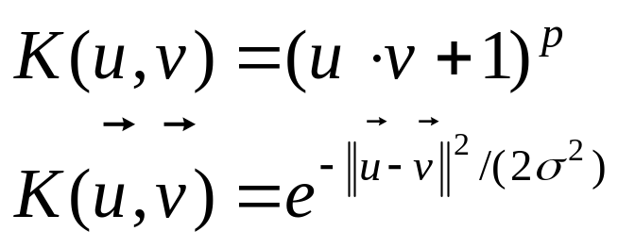
Issues in Non-linear SVM
Some Kernel Functions are:

Slide 44
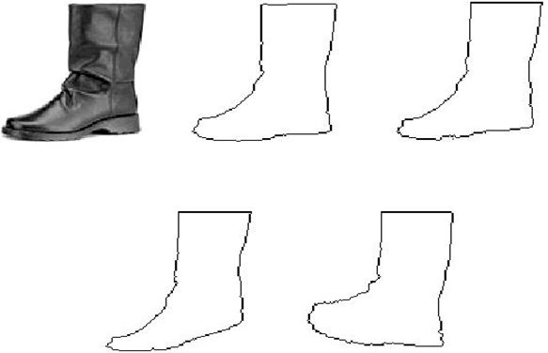
Template Matching

Slide 45
Template Matching
Typical Applications
  Speech Recognition
  Motion Estimation in Video Coding
  Data Base Image Retrieval
  Written Word Recognition
  Bioinformatics

Slide 46
Template Matching
The Goal:
  Given a set of reference patterns known as TEMPLATES,
  find the best match for unknown pattern
  each class represented by a single typical pattern.
requires an appropriate “measure” to quantify similarity or matching.

Slide 47
Template Matching
The cost “measure”:
  deviations between the template and the test pattern.

Slide 48
Template Matching
The cost “measure”:
  deviations between the template and the test pattern.
  For example:
    The word beauty may have been read as beeauty or beuty, etc., due to errors.
    The same person may speak the same word differently.

Slide 49
Template Matching Methods
Optimal path searching techniques
Correlation
Deformable models

Slide 50


TM using Optimal Path Searching
Representation: Represent the template by a sequence of measurement vectors or string patterns
  Template:
  Test pattern:

Slide 51

TM using Optimal Path Searching
  Template:
  Test pattern:
In general
We need to find an appropriate distance measure between test and reference patterns.

Slide 52
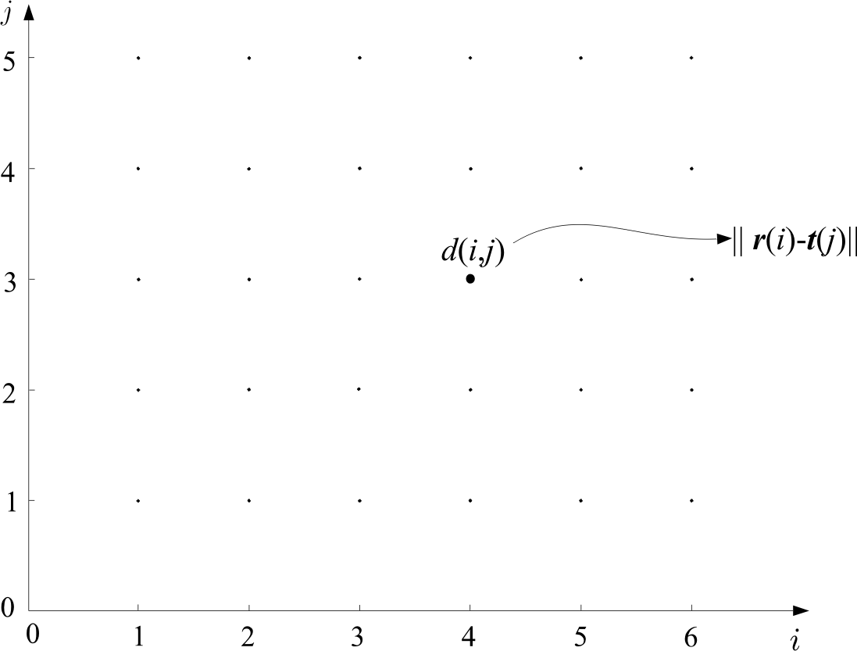
TM using Optimal Path Searching
  Form a grid with I points (template) in horizontal and J points (test) in vertical
  Each point (i,j) of the grid measures the distance between r(i) and t(j)

Slide 53
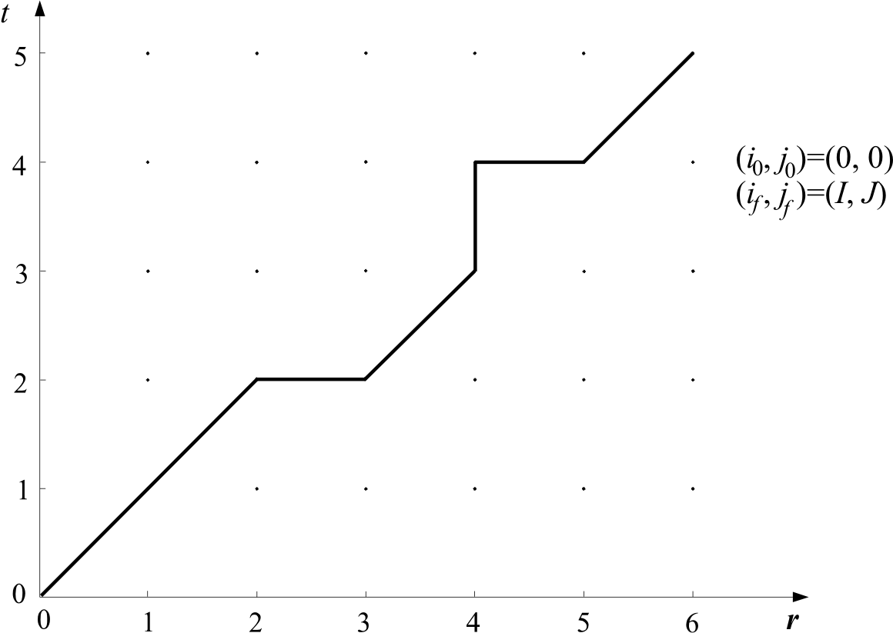
TM using Optimal Path Searching
  Path: A path through the grid, from an initial node
  (i₀, j₀) to a final one (i_{f}, j_{f}), is an ordered set of nodes
  (i₀, j₀), (i₁, j₁), (i₂, j₂) … (i_{k}, j_{k}) … (i_{f}, j_{f})

Slide 54



TM using Optimal Path Searching
  Path: A path is complete path if:

Slide 55
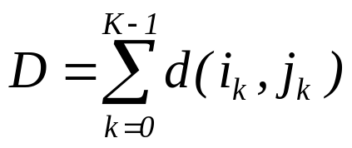
TM using Optimal Path Searching
  Each path is associated with a cost
  where K is the number of nodes across the path

Slide 56

TM using Optimal Path Searching
Let the cost up to node (i_{k}, j_{k}) be
By convention
  D(0, 0)=0
  d(0,0)=0

Slide 57
TM using Optimal Path Searching
The equation
assumes that each node has been associated with some cost

Slide 58

TM using Optimal Path Searching
The equation
assumes that each node has been associated with some cost
However, each transition (i_{k-1}, j_{k-1}) to (i_{k}, j_{k}) may also associate with a cost
The new equation is:

Slide 59


TM using Optimal Path Searching
  Search for the path with the optimal cost D_{opt.}
  The matching cost between template and test pattern is D_{opt.}
  Costly operation
  Needs efficient computation

Slide 60
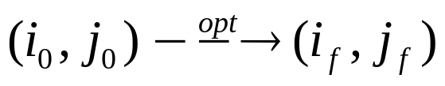
Bellman’s Optimality Principle
Optimal path:

Slide 61
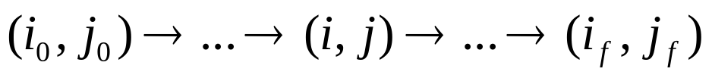
Bellman’s Optimality Principle
Optimal path:
Let (i,j) be an intermediate node, i.e.

Slide 62
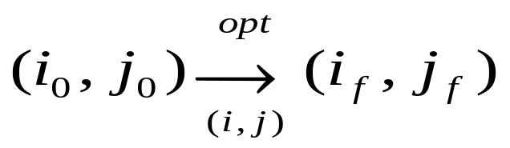
Bellman’s Optimality Principle
Optimal path:
Let (i,j) be an intermediate node, i.e.
Then, write the optimal path through (i, j)

Slide 63
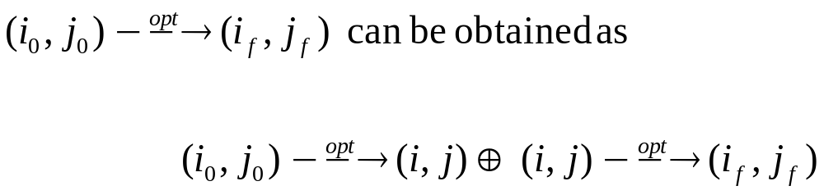
Bellman’s Optimality Principle
Bellman’s Principle:
meaning: The overall optimal path from (i₀,j₀) to (i_{f},j_{f}) through (i,j) is the concatenation of the optimal paths from (i₀,j₀) to (i,j) and from (i,j) to (i_{f},j_{f})

Slide 64
Bellman’s Optimality Principle
Bellman’s Principle:
Let D_{opt.} (i_{k-1} ,j_{k-1}) is the optimal path to reach (i_{k-1} ,j_{k-1}) from (i₀,j₀), then Bellman’s principle is stated as:

Slide 65
Bellman’s Optimality Principle
We don’t need to search the whole space to find the optimal path
Global and local constraints may be imposed to reduce the search space

Slide 66
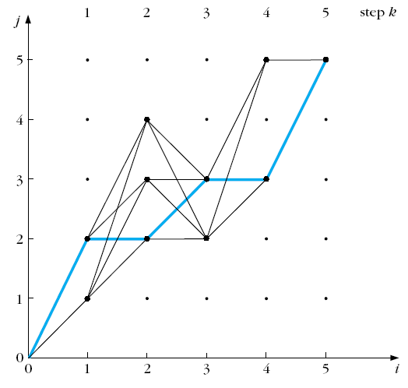
Bellman’s Optimality Principle
We don’t need to search the whole space to find the optimal path
Global and local constraints may be imposed to reduce the search space

Slide 67
Application of TM in Text Matching:
The Edit Distance
The Edit distance
  It is used for matching written words. Applications:
    Automatic Editing
    Text Retrieval

Slide 68
Application of TM in Text Matching:
The Edit Distance
The Edit distance
  It is used for matching written words. Applications:
    Automatic Editing
    Text Retrieval
  The measure to be adopted for matching, must take into account:
    Wrongly identified symbols
    e.g. “befuty” instead of “beauty”
    Insertion errors, e.g. “bearuty”
    Deletion errors, e.g. “beuty”

Slide 69
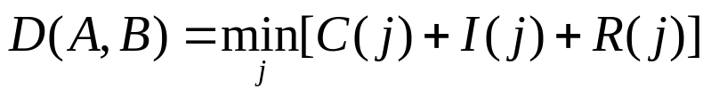
The Edit Distance
Edit distance: Minimal total number of changes, C, insertions I and deletions R, required to change pattern A into pattern B,
where j runs over All possible variations of symbols, in order to convert A B

Slide 70
The Edit Distance
Edit distance: Minimal total number of changes, C, insertions I and deletions R, required to change pattern A into pattern B,
where j runs over All possible variations of symbols, in order to convert A B
Example: many ways to change beuty to beauty

Slide 71
The Edit Distance
The optimal path search algorithm can be used, provided we know
  Initial conditions
  Search space
  Allowable transitions
  Distance measure

Slide 72

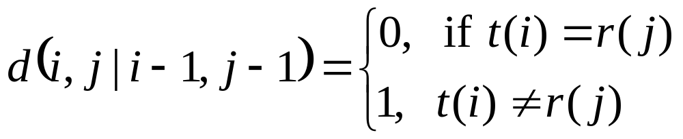
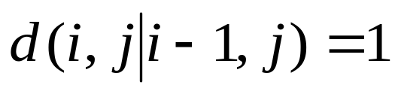
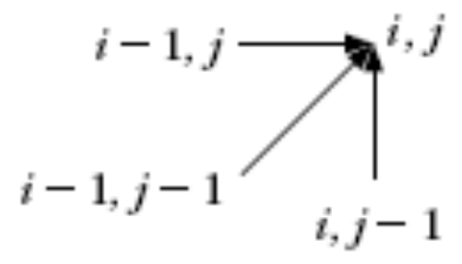
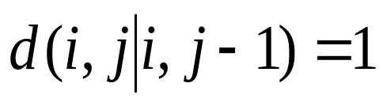
The Edit Distance
Cost D(0,0) = 0,
Complete path is searched
Allowable predecessors and costs:
  Horizontal
  Vertical

Slide 73
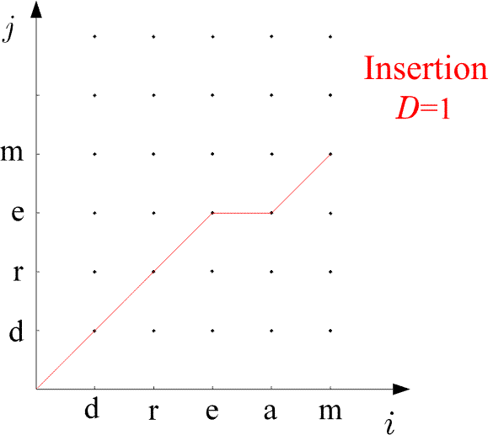
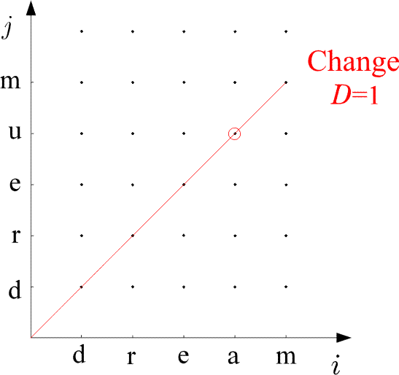
Examples:

Slide 74
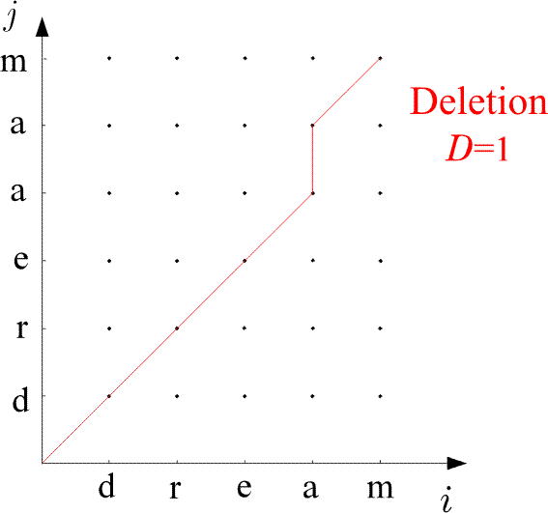
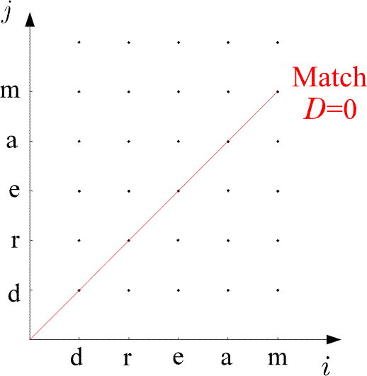
Examples:

Slide 75
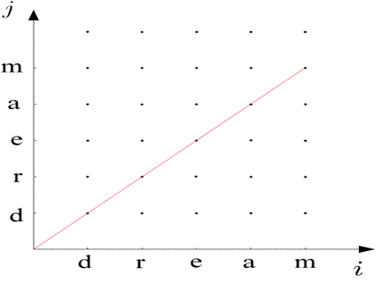
The Edit Distance
The Algorithm
  D(0,0)=0
  For i=1, to I
    D(i,0)=D(i-1,0)+1
  END {FOR}
  For j=1 to J
    D(0,j)=D(0,j-1)+1
  END{FOR}
  For i=1 to I
    For j=1, to J
      C₁=D(i-1,j-1)+d(i,j ׀ i-1,j-1)
      C₂=D(i-1,j)+1
      C₃=D(i,j-1)+1
      D(i,j)=min (C₁,C₂,C₃)
    END {FOR}
  END {FOR}
  D(A,B)=D(I,J)

Slide 76
Application of TM in Speech Recognition
A number of variations
  Speaker Independent Speech Recognition
  Speaker Dependent Speech Recognition
  Continuous Speech Recognition
  Isolated word recognition (IWR)

Slide 77
Application of TM in IWR
The goal:
  Given a number of known spoken words in a data base (reference patterns)
  find the best match of an unknown spoken word (test pattern).
Procedure:
  compare the test word against reference words

Slide 78
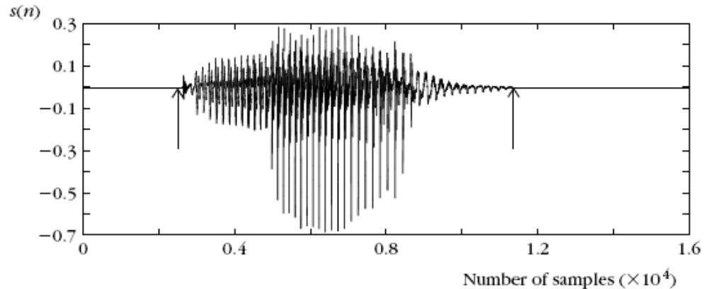
Application of TM in IWR

Slide 79
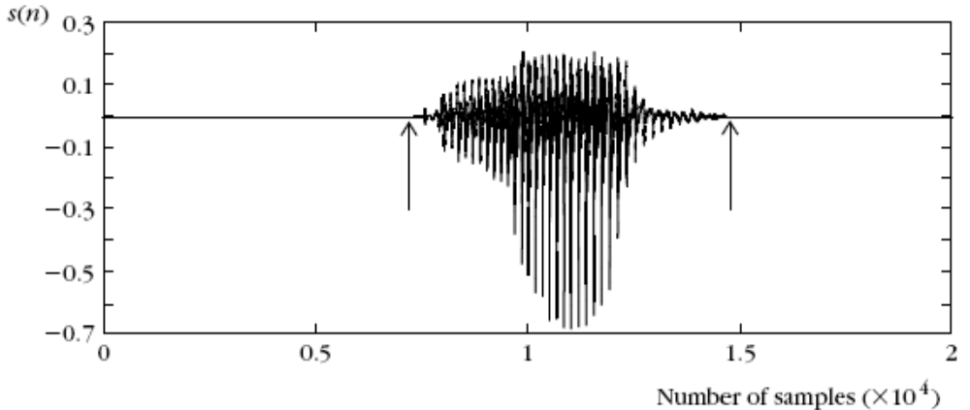
Application of TM in IWR

Slide 80


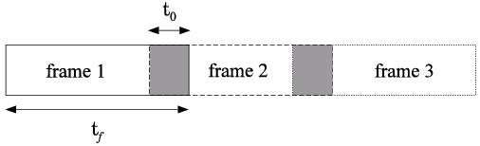
Application of TM in IWR
The procedure:
  Express the test and each of the reference patterns as sequences of feature vectors , , .
  To this end, divide each of the speech segments in a number of successive frames.

Slide 81
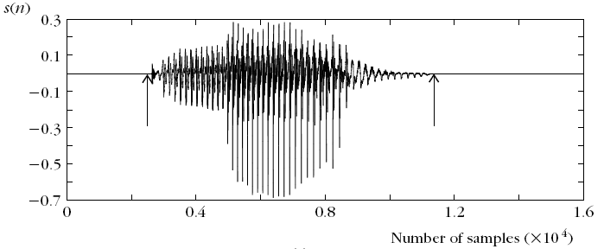
Application of TM in IWR
The procedure:
  Sample a speech segment from a microphone:

Slide 82
Application of TM in IWR
The procedure:
t_{f} = 512
t₀ = 100
Frame 1
Frame 2
Frame 2

Slide 83
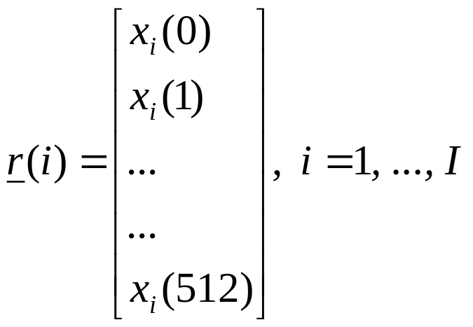
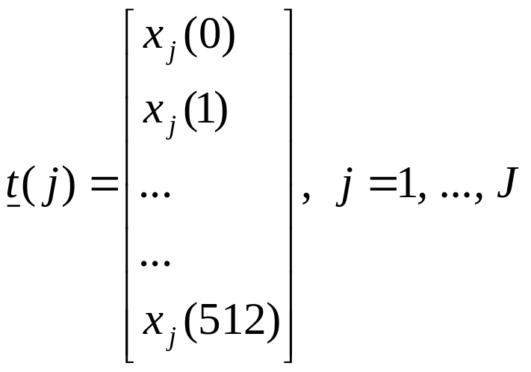
each frame is represented by a vector of 512 samples

Slide 84


convert them to DFT

Slide 85

convert them to DFT

Slide 86


    For each frame compute a feature vector. For example, the DFT coefficients and use, say, ℓ of those:

Slide 87

    For each frame compute a feature vector. For example, the DFT coefficients and use, say, ℓ of those:
    Choοse a cost function associated with each node across a path, e.g., the Euclidean distance

Slide 88
    For each frame compute a feature vector. For example, the DFT coefficients and use, say, ℓ of those:
    Choοse a cost function associated with each node across a path, e.g., the Euclidean distance
    find the optimal path in the grid
    Match the test pattern to the reference pattern associated with the optimal path

Slide 89
  Prior to performing the math one has to choose:
    end point constraints
    global constraints
    local constraints
    distance

Slide 90

  Prior to performing the math one has to choose:
    The global constraints: Defining the region of space within which the search for the optimal path will be performed.

Slide 91

    The local constraints: monotonic path

Slide 92

    The local constraints: monotonic path
    Non-monotonic path

Slide 93

    The local constraints: Defining the type of transitions allowed between the nodes of the grid.
    Itakura local constraints

Slide 94

    The local constraints: Defining the type of transitions allowed between the nodes of the grid.
Sakoe and Chiba local constraints

Slide 95

    cost function:
      Euclidean distance
      only node distance

